Slide 1
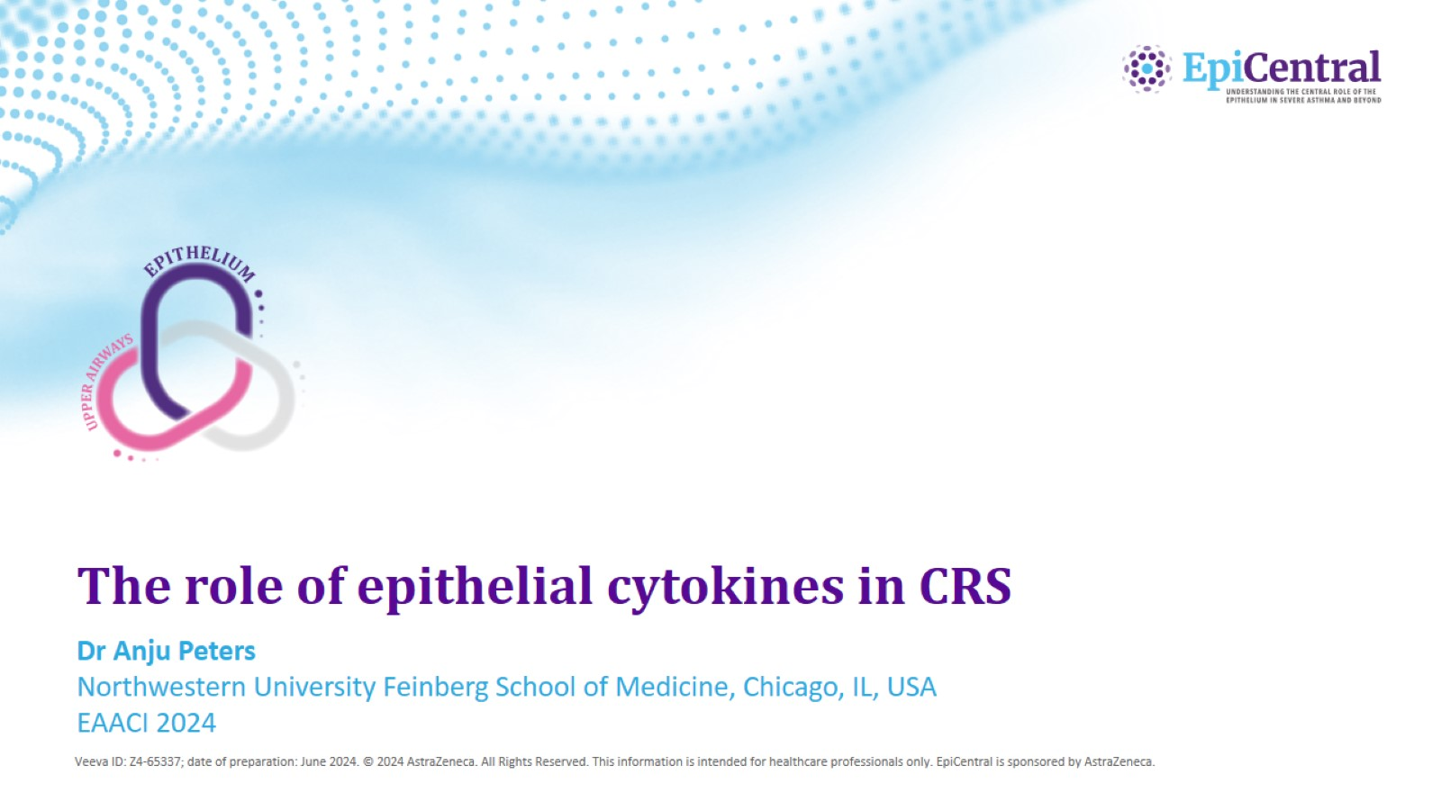
The role of epithelial cytokines in CRS

Slide 2
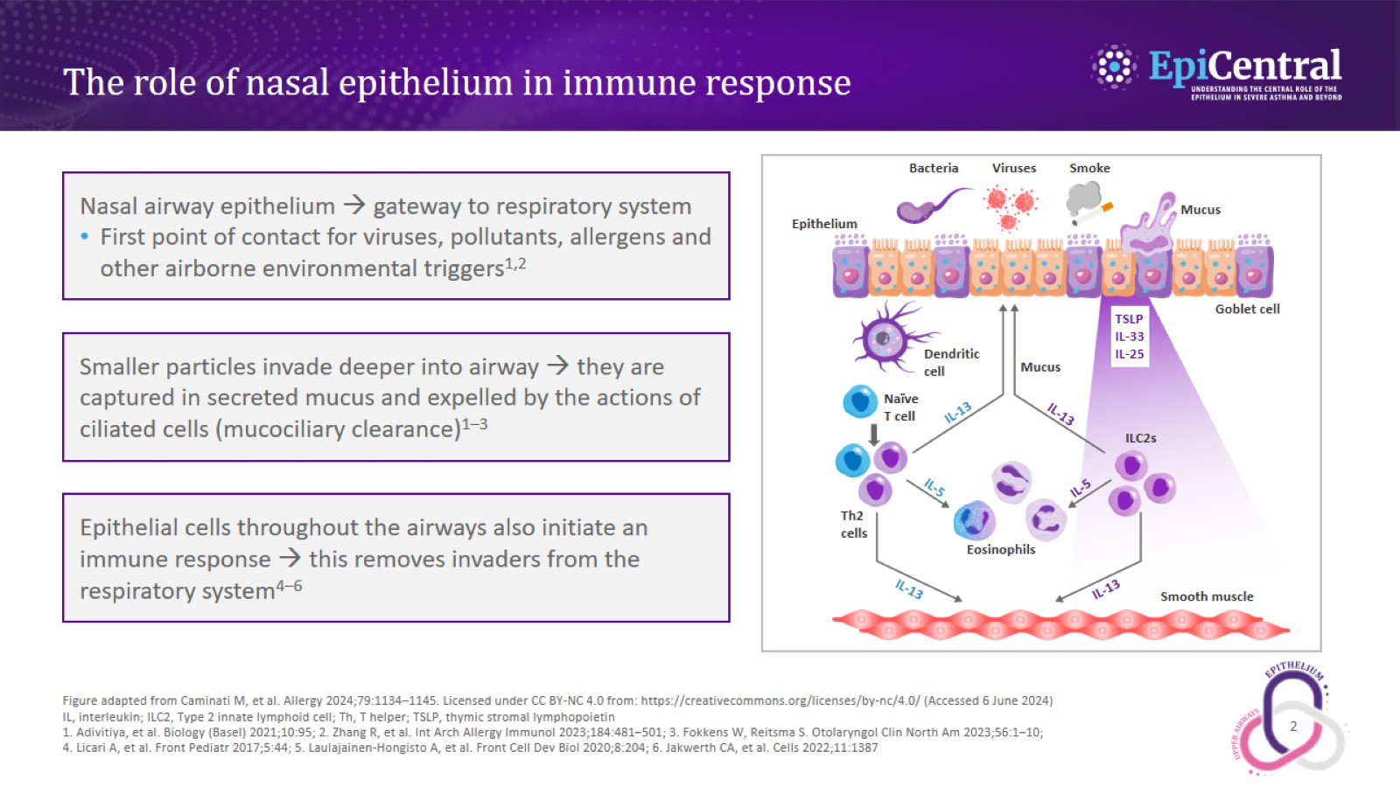
The role of nasal epithelium in immune response

Slide 3
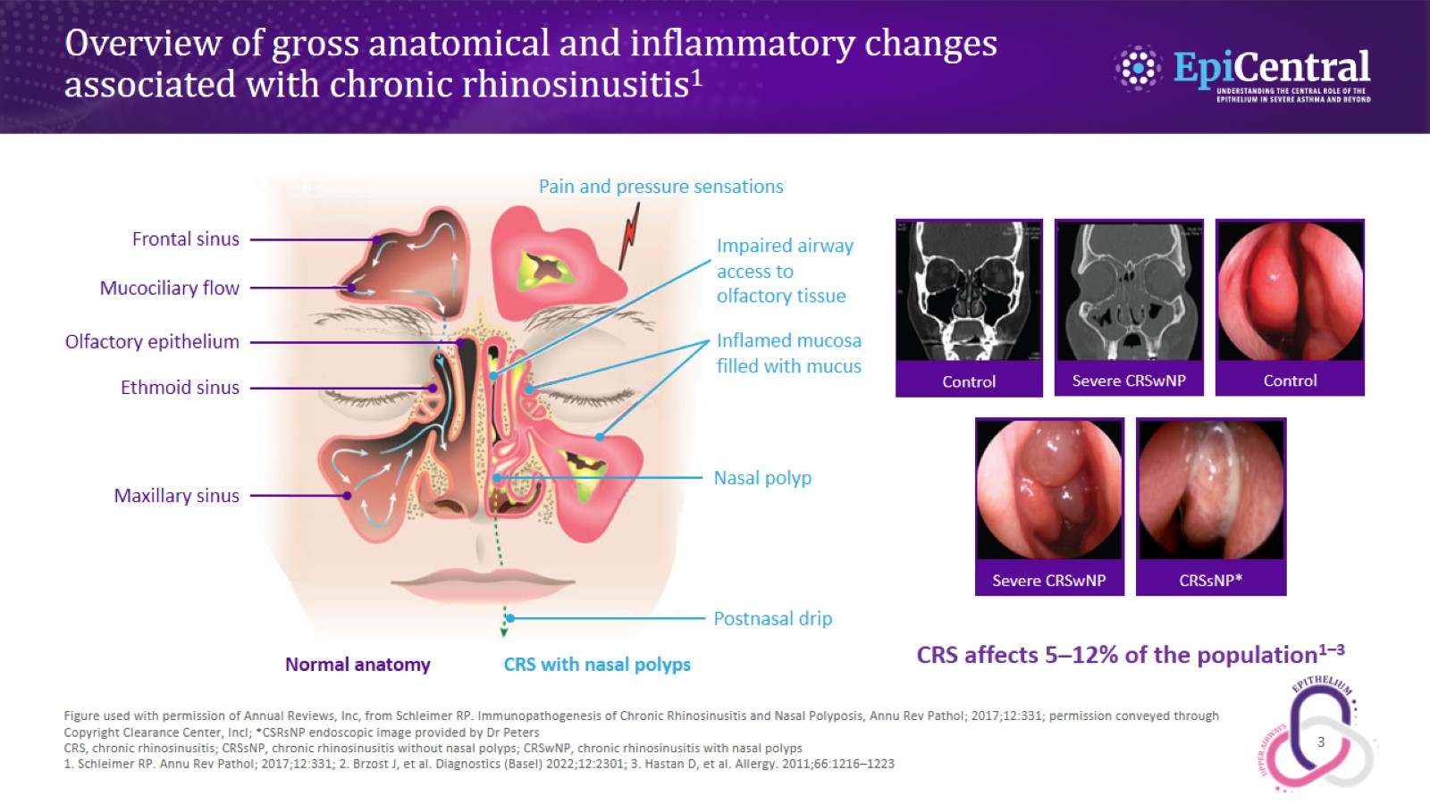
Overview of gross anatomical and inflammatory changes associated with chronic rhinosinusitis¹

Slide 4
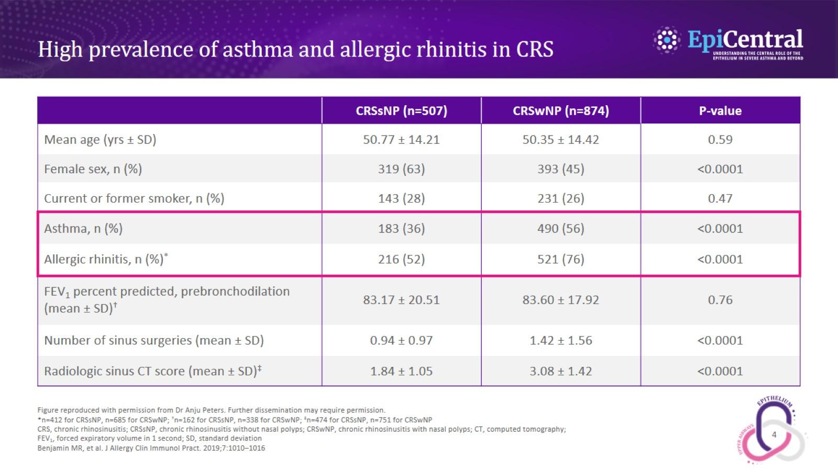
High prevalence of asthma and allergic rhinitis in CRS

Slide 5
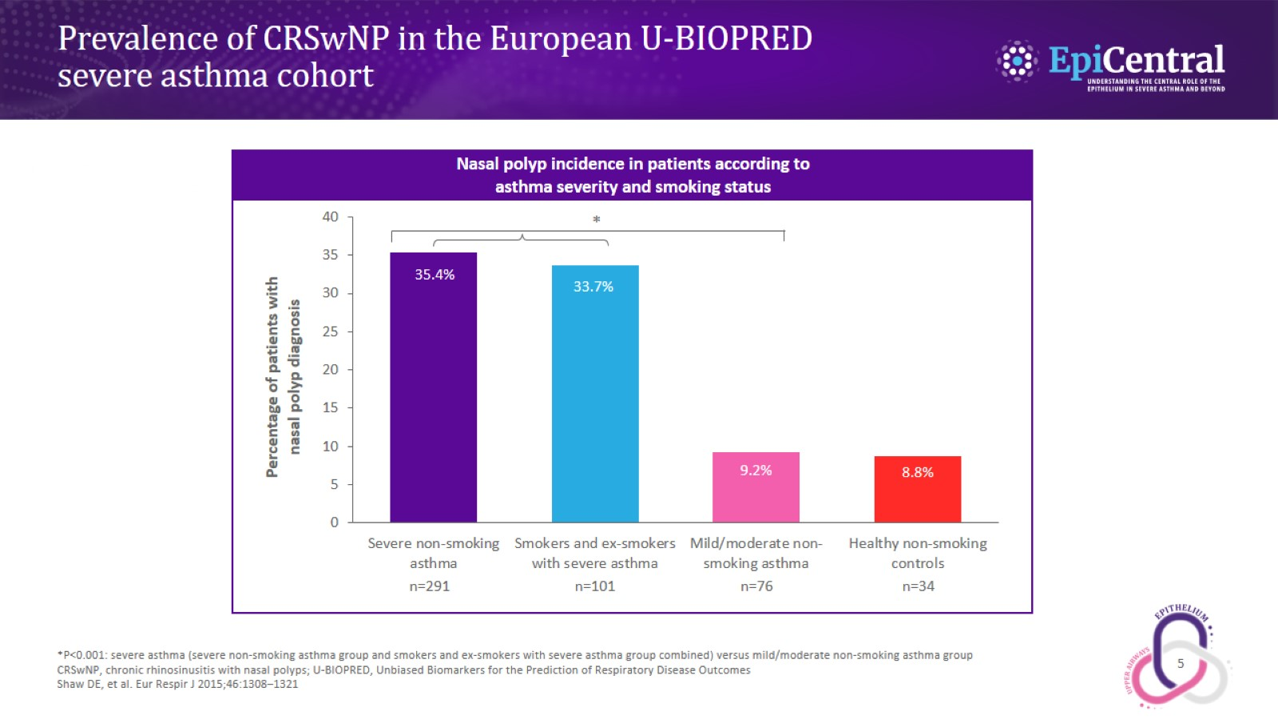
Prevalence of CRSwNP in the European U‑BIOPRED severe asthma cohort

Slide 6
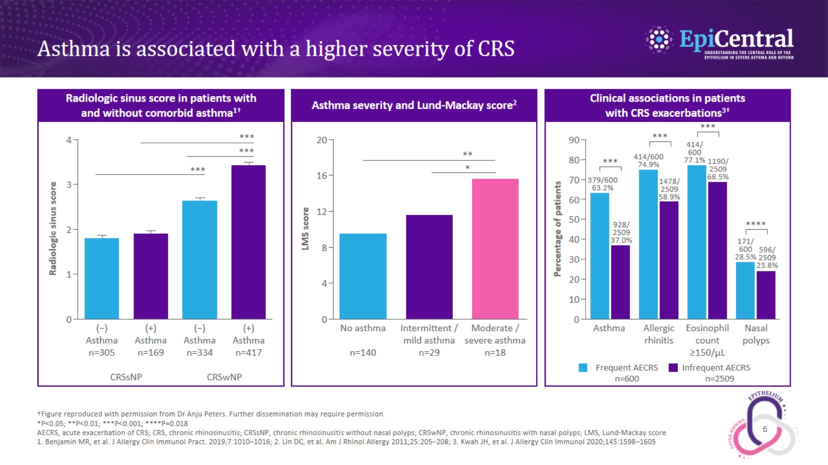
Asthma is associated with a higher severity of CRS

Slide 7
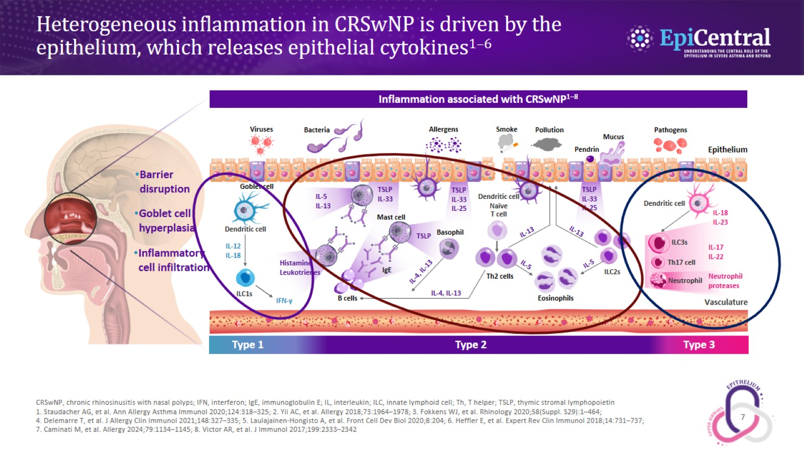
Heterogeneous inflammation in CRSwNP is driven by the epithelium, which releases epithelial cytokines^{1–6}

Slide 8
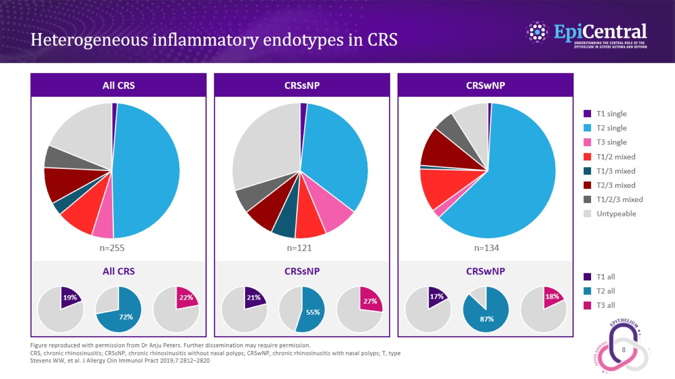
Heterogeneous inflammatory endotypes in CRS

Slide 9
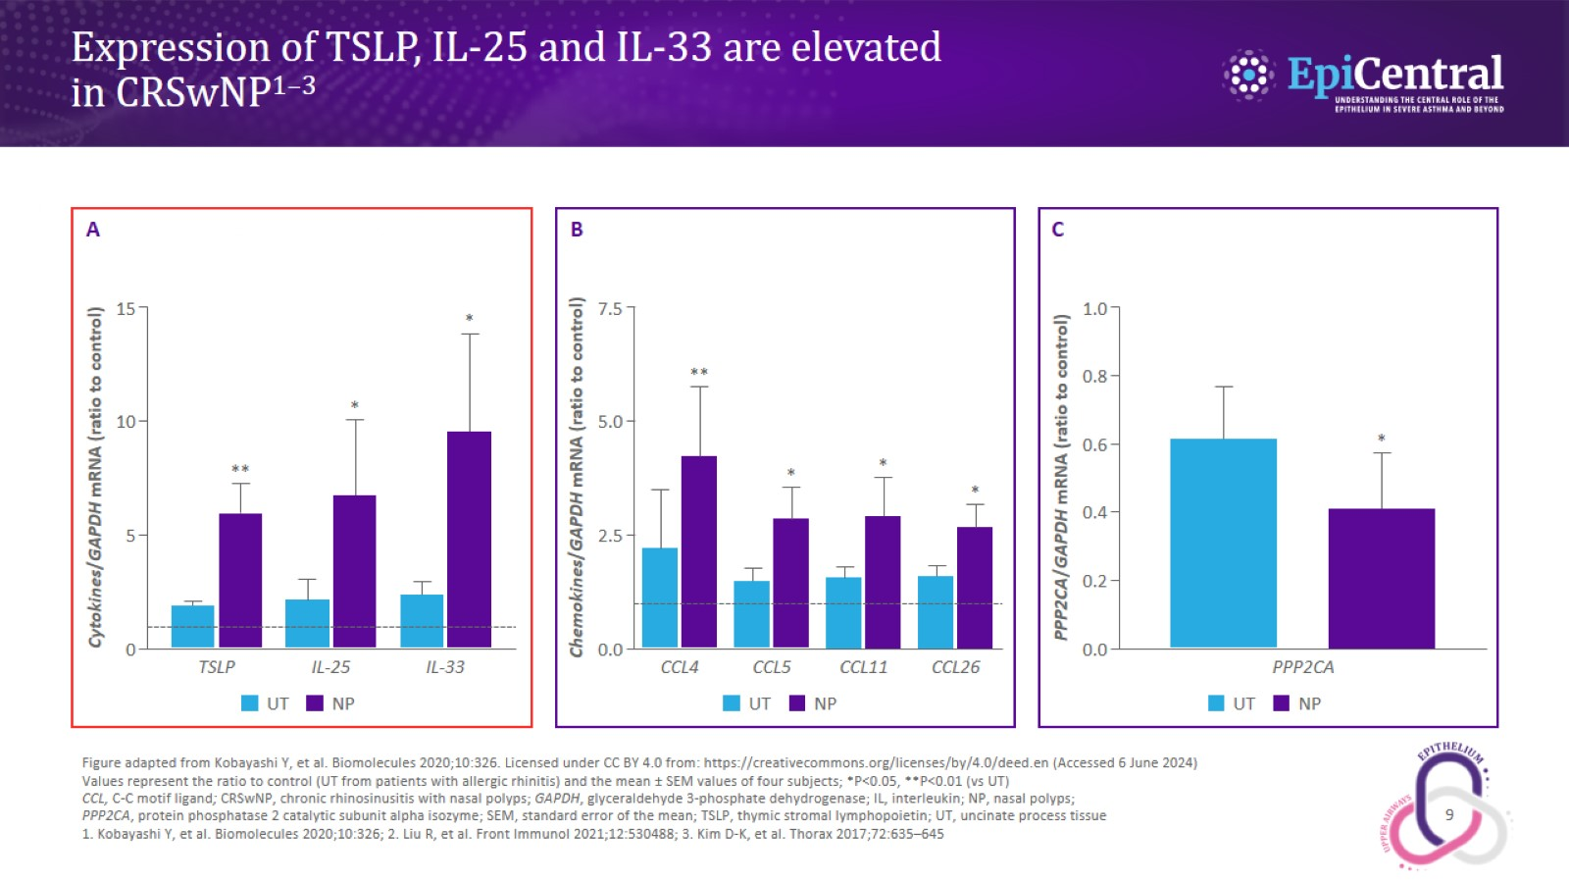
Expression of TSLP, IL‑25 and IL‑33 are elevated in CRSwNP^{1–3}

Slide 10
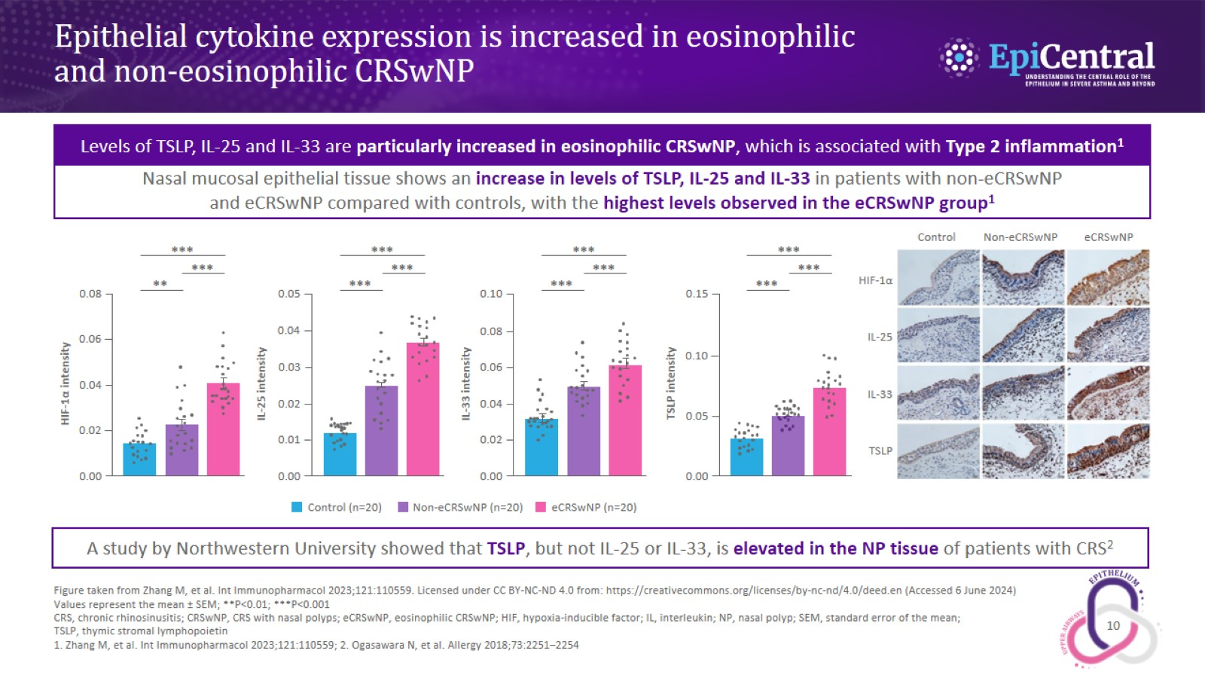
Epithelial cytokine expression is increased in eosinophilic and non‑eosinophilic CRSwNP

